Slide 1

Learning Objectives
You will learn the following concepts:
Azure Managed Identity
Authentication with Azure managed identities
Using managed identities with Azure resources
Azure Key Vault
Azure Security Center
Key Vault users

Slide 2
Azure Managed Identity

Slide 3
Authentication with Azure Managed Identities
A managed identity:
combines Azure AD authentication and Azure RBAC
eliminates the need for rotating credentials or certificates
The concept of managed identities involves the use of:
Client ID
Object ID
Azure Instance Metadata Service
There are two types of managed identities:
System-assigned managed identity
User-assigned managed identity

Slide 4
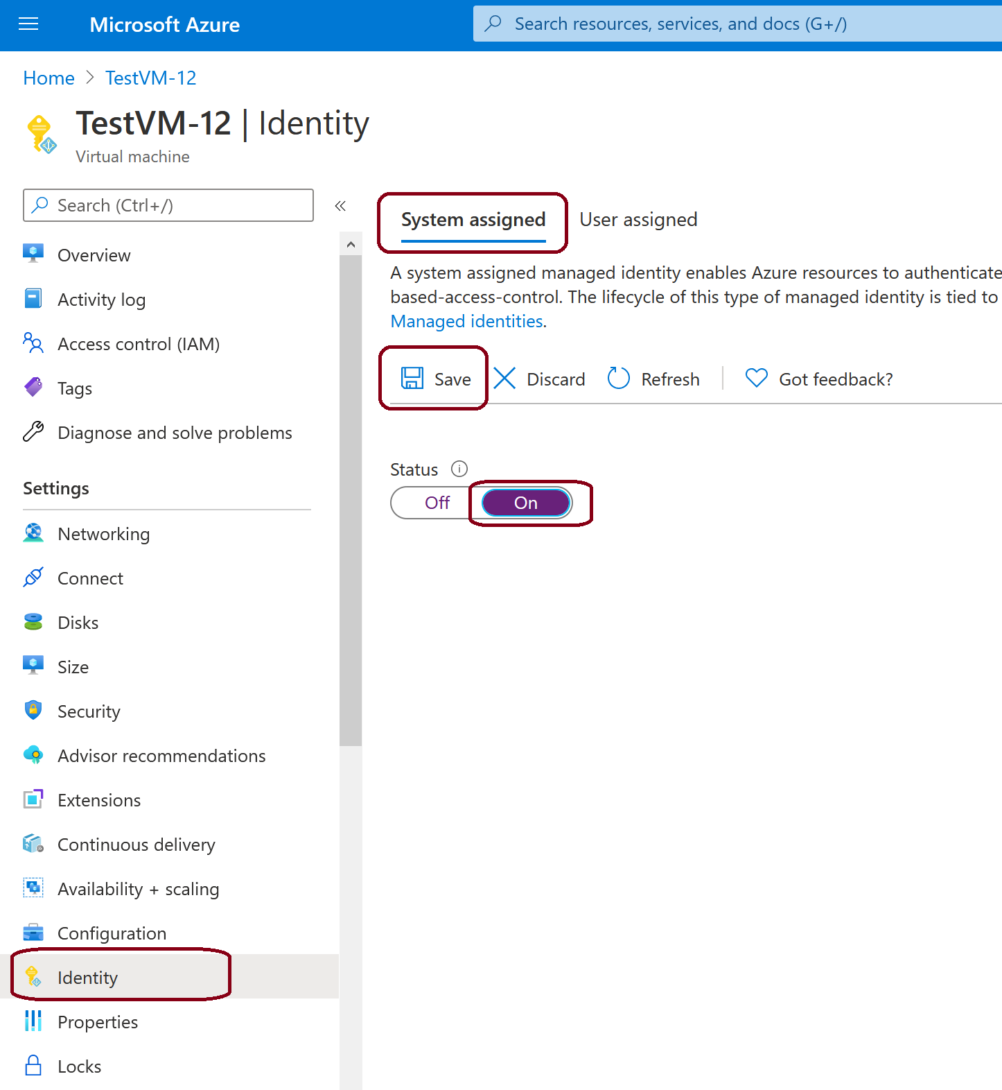
Using Managed Identities with Azure Resources
To set up a managed identity:
In the Azure portal, go to the VM that hosts the app you want to authenticate
On the overview page, under Settings, select Identity
Choose a system-assigned or user-assigned identity
Save your changes

Slide 5
Managed Identities for Azure Resources in Azure AD
Help you manage the credentials for authenticating to cloud services, when building cloud applications:
Keeps credentials out of code
Identity automatically managed in Azure AD for Azure resources
Uses a local MSI endpoint to get access tokens from Azure AD
Direct authentication with services or retrieve credentials from Azure Key Vault
App Service
Azure Service
(Azure Resource Manager, Key Vault)
Your code
Local token service
Credentials
Azure (inject and roll credentials)
Notes:
Explain that the following terms are used throughout this section of the course:
Client ID: A unique identifier generated by Azure AD that is tied to an application and service principal during its initial provisioning.
Principal ID: The object ID of the service principal object for your managed identity that is used to grant role-based access to an Azure resource.
Azure Instance Metadata Service: A REST endpoint accessible to all IaaS VMs created via the Azure Resource Manager. The endpoint is available at a well-known non-routable IP address (169.254.169.254) that can be accessed only from within the VM.
Discuss each term and its definition with the class.
AWS compare note: AWS Developers are often using either the AWS IAM SDK or Amazon Cognito to authenticate.
Simple steps to Enable system-assigned managed identity on an existing VM for optional quick demo
To enable system-assigned managed identity on a VM that was originally provisioned without it, your account needs the Virtual Machine Contributor role assignment. No additional Azure AD directory role assignments are required.
Sign in to the Azure portal using an account associated with the Azure subscription that contains the VM.
Navigate to the desired Virtual Machine and select Identity.
Under System assigned, Status, select On and then click Save:

Slide 6
Azure Key Vault

Slide 7





Azure Key Vault Overview
Administrator with Azure subscription creates and manages the vault and keys
Secrets management
Key management
Certificate management
Storing secrets
Azure Key Vault
Usage logging for keys
URIs for keys
Security administrator
Azure developer

Slide 8
Azure Key Vault
Azure Key Vault is a service that facilitates storage and management of:
Secrets
Keys
Certificates
Keys
hardware-protected by using HSMs that provide a hardened, tamper-resistant environment for cryptographic processing and key generation
software-protected by using software-based RSA and ECC algorithms
Secrets
Small (less than 10K) data blobs protected by a HSM-generated key

Slide 9
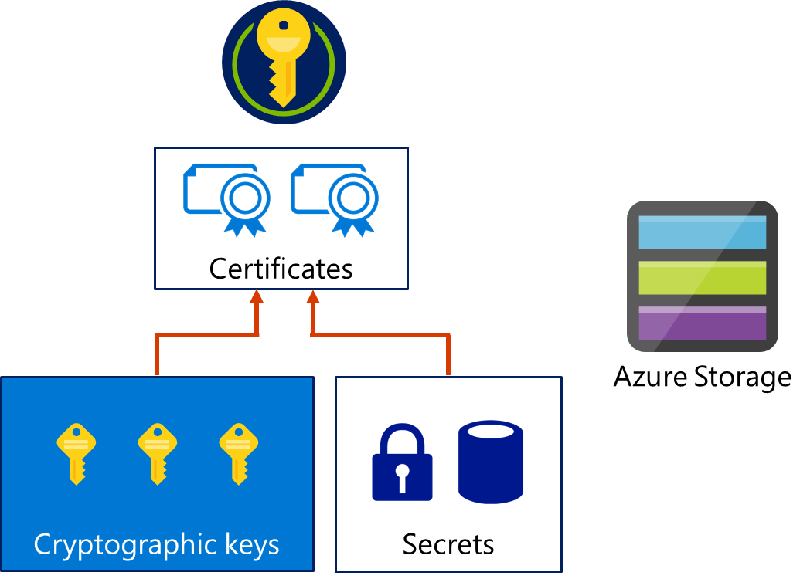
Key Vault Secret Types
Notes:
Key Vault enables Azure applications and users to store and use several types of secret/key data, including:
Cryptographic keys. Key Vault supports multiple key types and algorithms and using hardware security modules (HSMs) for high-value keys.
Secrets. Key Vault provides secure storage of secrets, such as passwords and database connection strings.
Certificates. Key Vault supports certificates, which are built on top of keys and secrets, and add an automated renewal feature.
Azure Storage. Key Vault can manage the keys of an Azure Storage account. Internally, Key Vault can list (sync) keys with an Azure Storage Account and regenerate (rotate) the keys periodically.

Slide 10
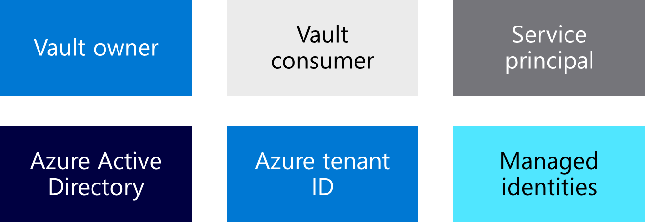
Key Vault Terminology
Notes:
Discuss each term and its definition with the class.
Vault owner:
Identity that has full control over the vault
Can grant other identities consumer (scoped) access to the vault
Vault consumer:
Identity that can perform actions on the assets inside the vault (with permission)
Managed identity:
Assigned identity for an Azure resource
Fastest way to access the vault from a service without sharing or exposing credentials
Service principal:
Can provide certificate or secret
Not recommended as it’s difficult to rotate
Azure Active Directory:
Used for secure access to the key vault management plane
Azure tenant ID:
Key vault is automatically tied to the default Azure Active Directory tenant ID for that subscription.
All access policy entries are also tied to this tenant ID.

Slide 11
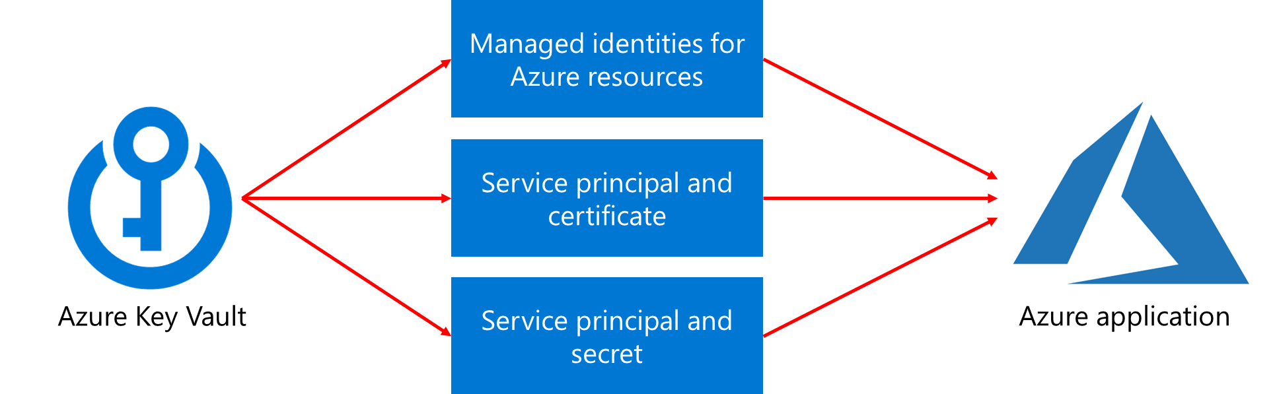
Authentication
Ways to authenticate to Key Vault:

Slide 12
Key Vault Users
Azure Key Vault helps manage the following tasks:
Secrets management
Key management
Certificate management
Best practices:
Grant access at a specific scope
Control what users have access to
Store certificates in the key vault
Ensures that you can recover a deleted key vault or key vault objects

Slide 13
Demonstration: Configure Certificate Auto-Rotation in Key Vault
Manage a certificate by using the Azure portal.
Add a CA provider account.
Update the certificate's validity period.
Update the certificate's auto-rotation frequency.
Update the certificate's attributes by using Azure PowerShell.

Slide 14

Module 11 Review Questions

